Slide 1
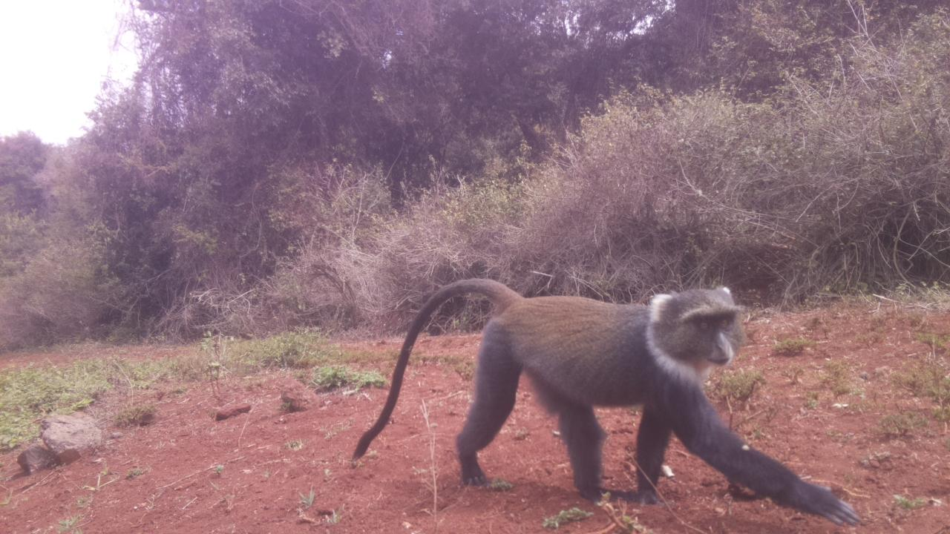
DSAIL-Porini: Annotated camera trap images of wildlife species from a conservancy in Kenya

Slide 2
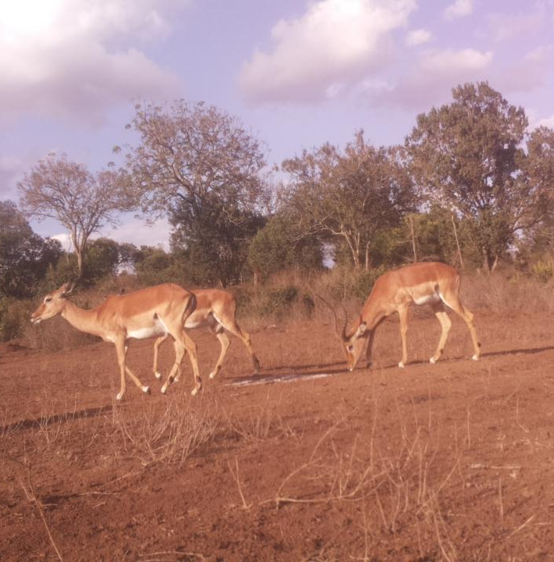
Introduction
Camera traps record accurate data in a non-invasive way
These data can be reviewed/used by other researchers.
Replaced traditional techniques
Deployed 4 camera traps for 7 months.

Slide 3
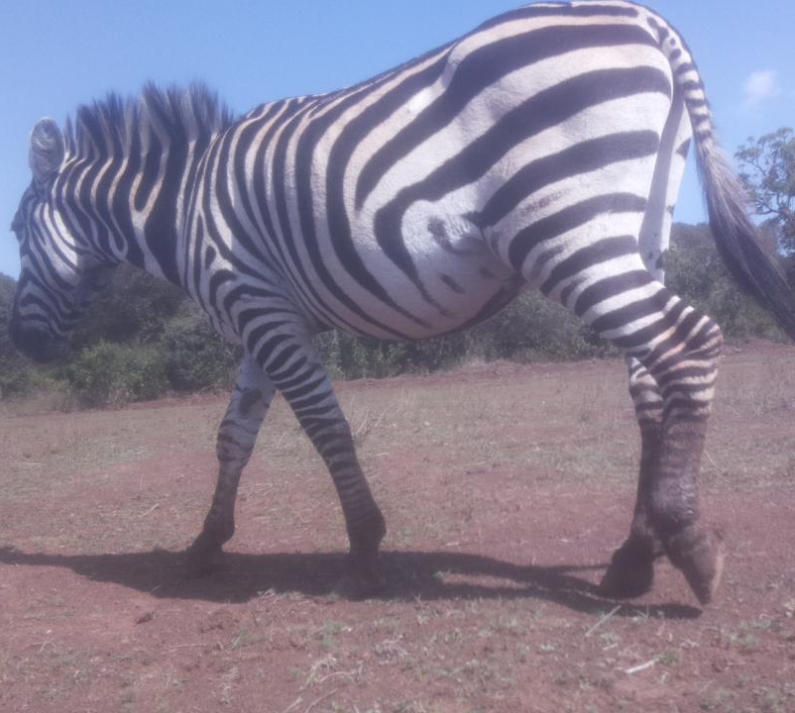
DSAIL-Porini Dataset
8524 annotated images of animals;
The dataset has 6 categories;
Impalas,
Warthogs,
Zebras,
Monkeys,
Waterbucks
Bushbucks.

Slide 4
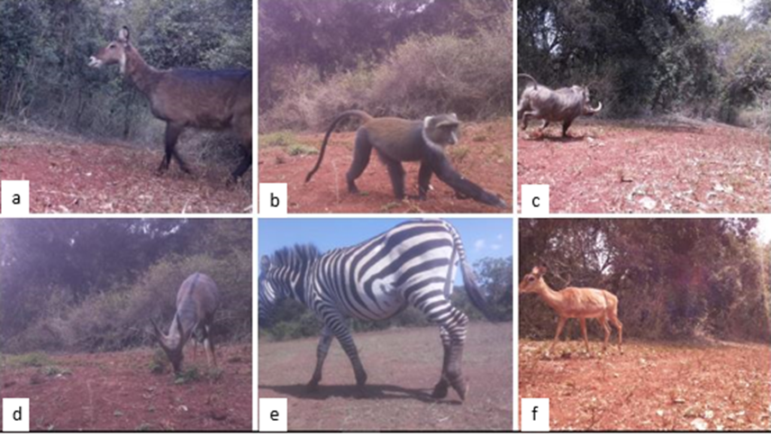
Species in the conservancy

Slide 5
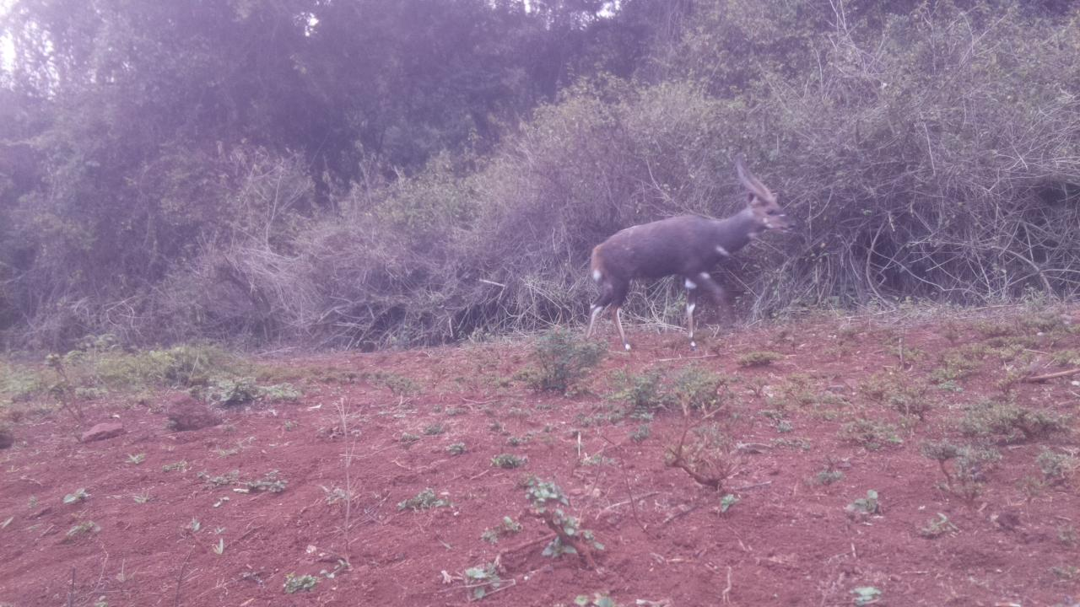
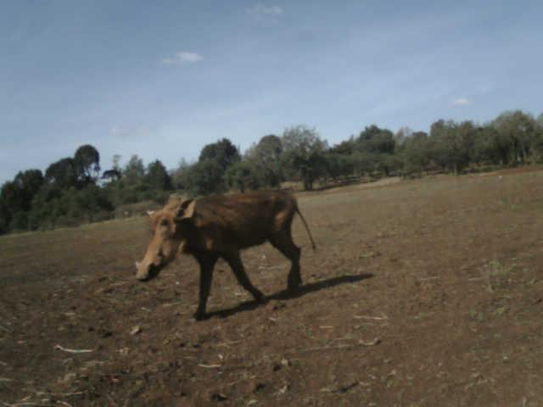
Value of the Data
Train machine learning models for classification and Object detection
Train and test image-based census algorithms as it includes animal counts.
Understand animal behaviour
Estimate the size of the animal population with time

Slide 6
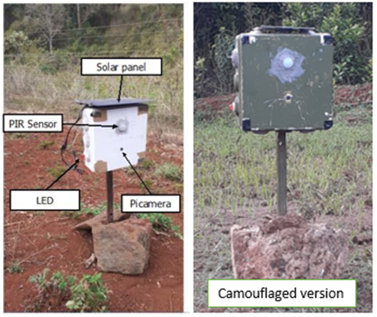
Deployment
Camouflage
Advantage: more close up images

Slide 7
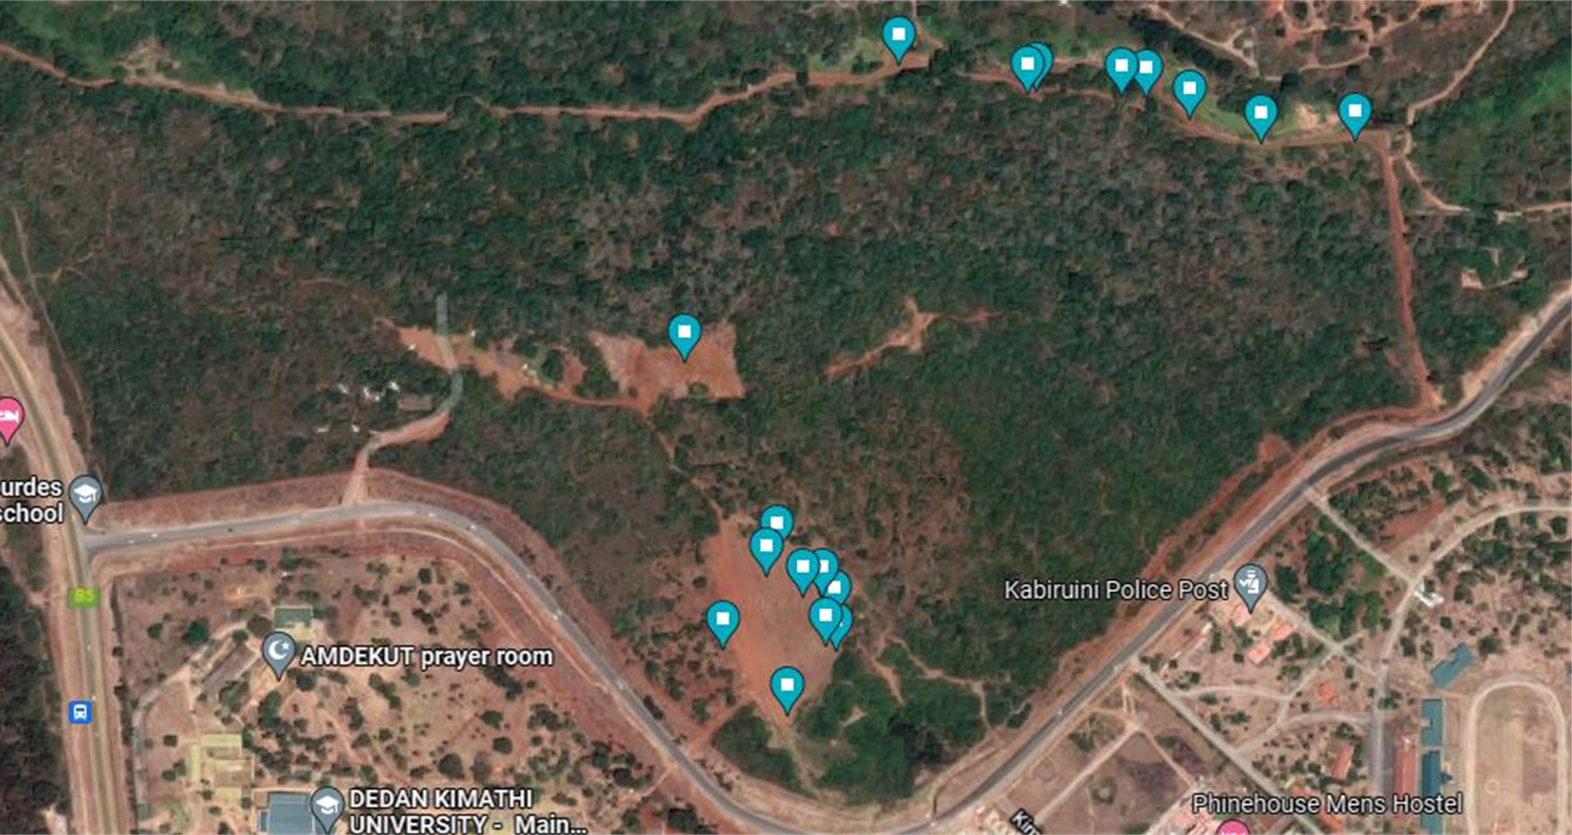
Camera trap placement

Slide 8
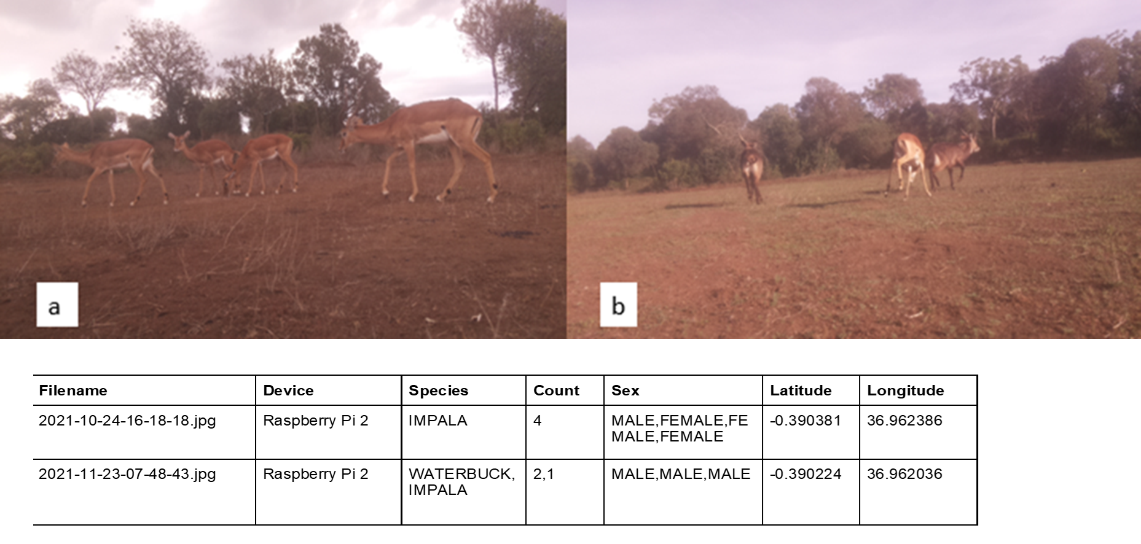
Data Annotation

Slide 9
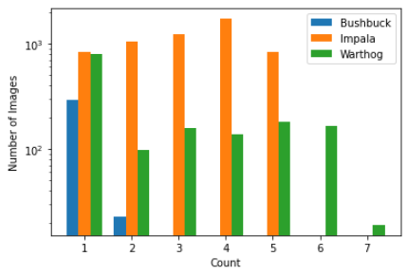
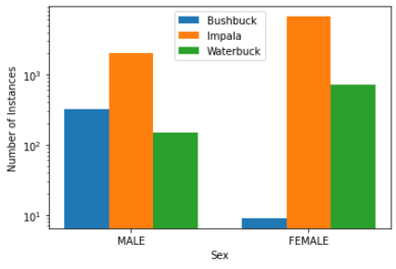
Data analysis
COUNT DISTRIBUTION
SEX DISTRIBUTION

Slide 10
THANK YOU

